Slide 1
TAILGATING DETECTION SYSTEM
Mayank Garg

Slide 2
Development Process
ANALYSIS
PROBLEM
PROJECT
IMPLEMENT
DESIGN
DEVELOP

Slide 3
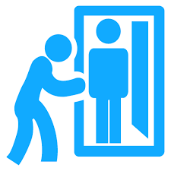
What is tailgating and why is it a problem?
The tailgating attack, also known as piggybacking, is a social engineering attack where the attacker gets inside a restricted area without proper authentication. The intruder walks behind a genuine authorized person to get inside the restricted access area.
It is one of the most common innocent and common breaches in the hacking world. In this scenario of attack, the cyber threat actor tries to trick an employee of the targeted company in order to get inside access of that company.
It is not possible as well as not feasible to actively monitor a restricted area all the time, which is one of the biggest reasons for this attack.
Tailgating is a massive issue for the organizations because the intruders / tailgaters can steal some confidential files or even inject some malware in the organization’s network.

Slide 4
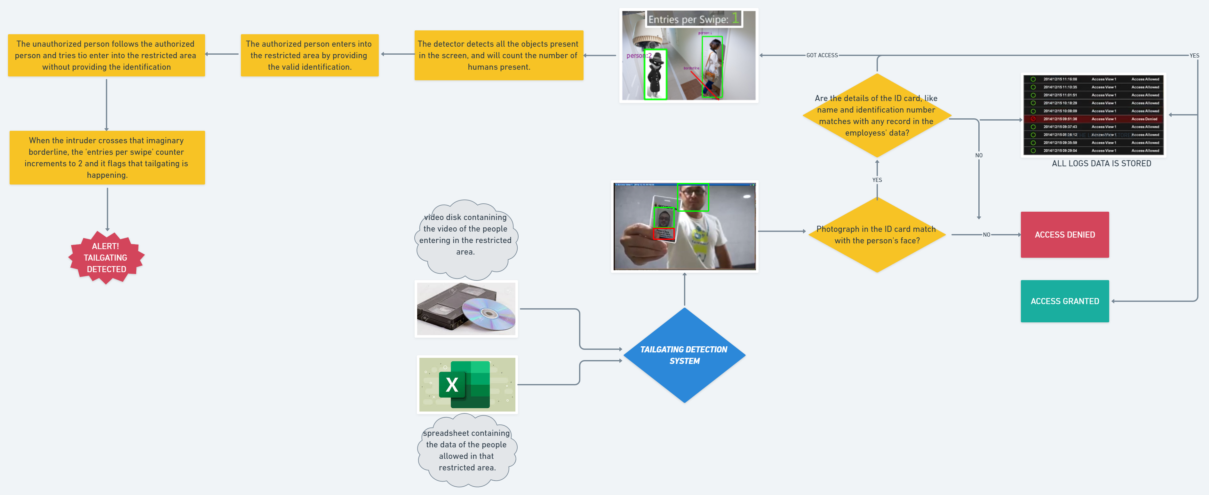
Design of the tailgating detection system

Slide 5
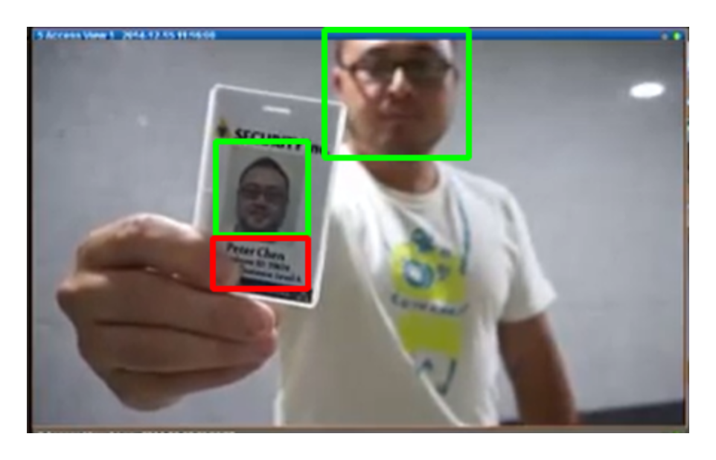
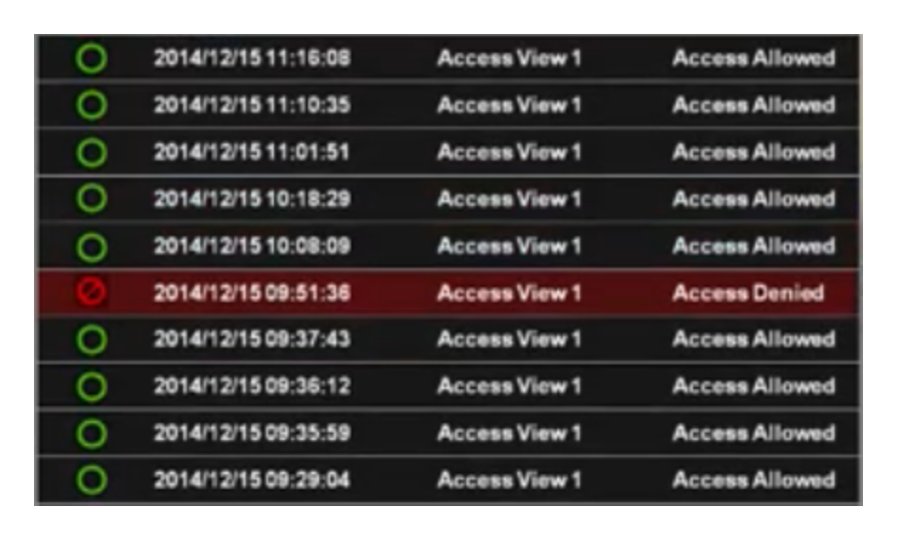
Brief explanation of the tailgating detection system
What will happen before the working of the tailgating detection system-
A person tries to enter into a restricted area. He provides some sort of identification, most probably an ID-card. The person’s information, like ID-number, name, etc., is stored in a spreadsheet.
To read the information and detect the face of person, OpenCV, a Python library will be used.
If the identification provided by the person trying to enter in that restricted area matches with the information in the spreadsheet, then the person will be authorized to enter.
If the identification provided does not matches with the information in the spreadsheet, then that person will be denied to access the restricted area.

Slide 6
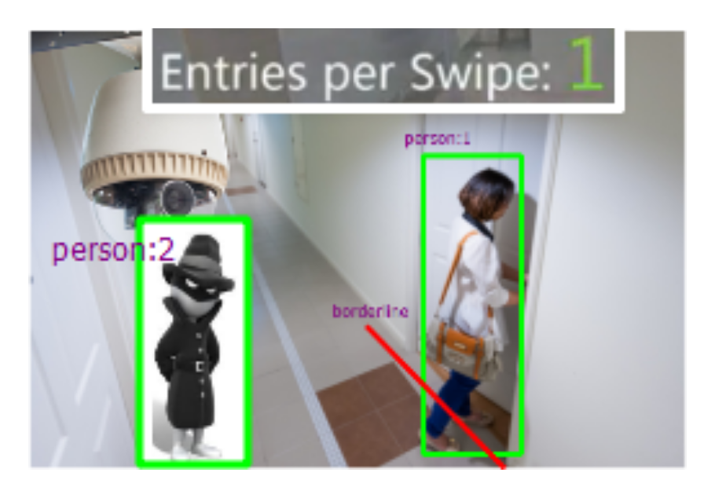
Tailgate detection-
First, the software will detect all the objects present in the screen. Then it will focus on the human objects and will count all of them. For object detection, ImageAI library is used with the object detection algorithms, for example, Faster R-CNN’s, YOLO, and Single Shot Detectors (SSDs)
Now all the focus will be put on the human objects, and all other objects will go un-noticed.
Now, we have to count the number of people present in the room / screen. To do this job, OpenCV, Numpy, dlib and imutils libraries of Python will be used.
The ‘entries per swipe’ counter will be 1 before any person provides identification.
If the identification provided is correct, then ‘entries per swipe’ counter will be dropped down to 0 (zero). And as soon as the person crosses that imaginary borderline, depicted in the design flow, the ‘entries per swipe’ counter will be incremented and will reach to 1 (one).
If any other person tries to enter into that restricted area, and as soon he crosses that imaginary borderline, the ‘entries per swipe’ counter will again be incremented and will reach to 2 (two), because this time the identification has not been provided and the ‘entries per swipe’ counter did not decrease to 0 (zero).
And with this, the tailgating detection system will flag that tailgating has been detected and some serious action should be taken against this.

Slide 7
Thank You

